Slide 1
Cryptography and Network Security
ELLIPTIC CURVES
ELLIPTIC CURVE CRYPTOGRAPHY

Slide 2
Session Meta Data
Author | Dr T Sree Sharmila
Reviewer
Version Number | 1.0
Release Date | 10 July 2018

Slide 3
Revision History
Revision Date | Details | Version no.
 |  | 1.0

Slide 4
Agenda
Introduction
Elliptic curve
Elliptic curve cryptography
Summary
Test your understanding
References

Slide 5
Lets start with a puzzle…
What is the number of balls that may be piled as a square pyramid and also rearranged into a square array?
Soln: Let x be the height of the pyramid…
Thus,
We also want this to be a square:
Hence,

Slide 6
Graphical Representation
Y axis
X axis
Curves of this nature
are called ELLIPTIC
CURVES

Slide 7
Introduction - ECC
Elliptic Curve (EC) systems as applied to cryptography were first proposed in 1985 independently by Neal Koblitz and Victor Miller.
The discrete logarithm problem on elliptic curve groups is believed to be more difficult than the corresponding problem in (the multiplicative group of nonzero elements of) the underlying finite field.

Slide 8
Discrete Logarithms in Finite Fields
F={1,2,3,…,p-1}
Pick secret, random Y from F
Pick secret, random X from F
g^{x} mod p
g^{y} mod p
Alice
Bob
Compute k=(g^{y})^{x}=g^{xy} mod p
Compute k=(g^{x})^{y}=g^{xy} mod p
Eve has to compute g^{xy} from g^{x} and g^{y} without knowing x and y…
She faces the Discrete Logarithm Problem in finite fields

Slide 9
Agenda
Introduction
Elliptic curve
Elliptic curve cryptography
Summary
Test your understanding
References

Slide 10
Elliptic Curve on a finite set of Integers
Consider y² = x³ + 2x + 3 (mod 5)
x = 0 ⇒ y² = 3 ⇒ no solution (mod 5)
x = 1 ⇒ y² = 6 = 1 ⇒ y = 1,4 (mod 5)
x = 2 ⇒ y² = 15 = 0 ⇒ y = 0 (mod 5)
x = 3 ⇒ y² = 36 = 1 ⇒ y = 1,4 (mod 5)
x = 4 ⇒ y² = 75 = 0 ⇒ y = 0 (mod 5)
Then points on the elliptic curve are
(1,1) (1,4) (2,0) (3,1) (3,4) (4,0) and the point at infinity: ∞
Using the finite fields we can form an Elliptic Curve Group
where we also have a DLP problem which is harder to solve…

Slide 11
Definition of Elliptic curves
An elliptic curve over a field K is a nonsingular cubic curve in two variables, f(x,y) =0 with a rational point (which may be a point at infinity).
The field K is usually taken to be the complex numbers, reals, rationals, algebraic extensions of rationals, p-adic numbers, or a finite field.
Elliptic curves groups for cryptography are examined with the underlying fields of F_{p} (where p>3 is a prime) and F₂^{m} (a binary representation with 2^{m} elements).

Slide 12
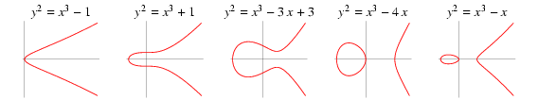
General form of a EC
An elliptic curve is a plane curve defined by an equation of the form
Examples

Slide 13
Weierstrass Equation
A two variable equation F(x,y)=0, forms a curve in the plane. We are seeking geometric arithmetic methods to find solutions
Generalized Weierstrass Equation of elliptic curves:
Here, A, B, x and y all belong to a field of say rational
numbers, complex numbers, finite fields (F_{p}) or
Galois Fields (GF(2^{n})).

Slide 14
If Characteristic field is not 2:
If Characteristics of field is neither 2 nor 3:

Slide 15
Points on the Elliptic Curve (EC)
Elliptic Curve over field L
It is useful to add the point at infinity
The point is sitting at the top of the y-axis and any line is said to pass through the point when it is vertical
It is both the top and at the bottom of the y-axis

Slide 16
The Abelian Group
Given two points P,Q in E(Fp), there is a third point, denoted by P+Q on E(Fp), and the following relations hold for all P,Q,R in E(Fp)
P + Q = Q + P (commutativity)
(P + Q) + R = P + (Q + R) (associativity)
P + O = O + P = P (existence of an identity element)
there exists ( − P) such that − P + P = P + ( − P) = O (existence of inverses)

Slide 17
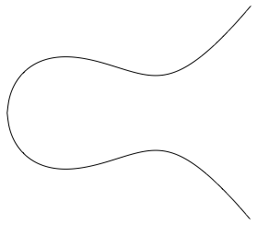
Elliptic Curve Picture
y
Consider elliptic curve
E: y² = x³ - x + 1
If P₁ and P₂ are on E, we can define
P₃ = P₁ + P₂
as shown in picture
Addition is all we need
P₂
P₁
x
P₃

Slide 18
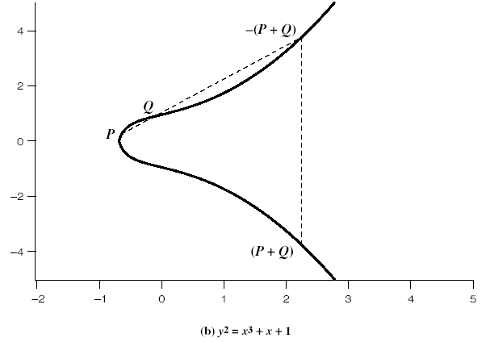
Addition in Affine Co-ordinates
y=m(x-x₁)+y₁
y
Let, P≠Q,
x
y²=x³+Ax+B

Slide 19
Doubling of a point
Let, P=Q
What happens when P₂=∞?

Slide 20

Why do we need the reflection?
y
P₂=O=∞
P₁=P₁+ O=P₁
P₁

Slide 21
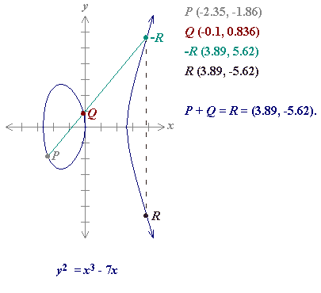
Sum of two points
Define for two points P (x₁,y₁) and Q (x₂,y₂) in the Elliptic curve
Then P+Q is given by R(x₃,y₃) :

Slide 22
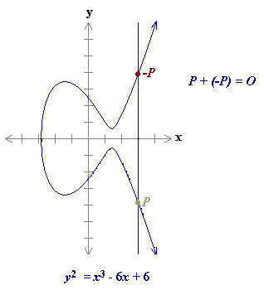
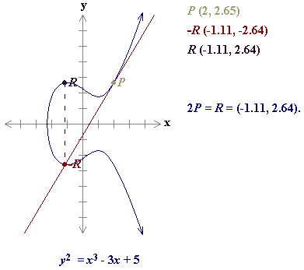
Point at infinity O
P+P = 2P
As a result of the above case P=O+P
O is called the additive identity of the elliptic curve group.
Hence all elliptic curves have an additive identity O.

Slide 23
Projective Co-ordinates
Two-dimensional projective space over K is given by the equivalence classes of triples (x,y,z) with x,y z in K and at least one of x, y, z nonzero.
Two triples (x₁,y₁,z₁) and (x₂,y₂,z₂) are said to be equivalent if there exists a non-zero element λ in K, st:
(x₁,y₁,z₁) = (λx₂, λy₂, λz₂)
The equivalence class depends only the ratios and hence is denoted by (x:y:z)

Slide 24
Projective Co-ordinates
If z≠0, (x:y:z)=(x/z:y/z:1)
What is z=0? We obtain the point at infinity.
The two dimensional affine plane over K:
There are advantages with projective co-ordinates
from the implementation point of view

Slide 25
Singularity
For an elliptic curve y²=f(x), define
F(x,y)=y²-F(x). A singularity of the EC is a pt (x₀,y₀) such that:
It is usual to assume the EC has no singular points

Slide 26
If Characteristics of field is not 3:
Hence condition for no singularity is 4A³+27B²≠0
Generally, EC curves have no singularity

Slide 27
Elliptic Curves in Characteristic 2
Generalized Equation:
If a₁ is not 0, this reduces to the form:
If a₁ is 0, the reduced form is:
Note that the form cannot be:

Slide 28
Agenda
Introduction
Elliptic curve
Elliptic curve cryptography
Summary
Test your understanding
References

Slide 29
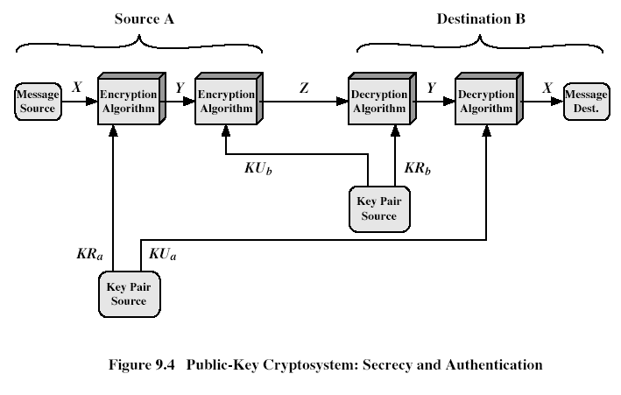
Public-Key Cryptosystems
Authentication: Only A can
generate the encrypted message
Secrecy: Only B can Decrypt
the message
Notes:
Stallings Fig 9-4.
Here see various components of public-key schemes used for both secrecy and authentication. Note that separate key pairs are used for each of these – receiver owns and creates secrecy keys, sender owns and creates authentication keys.

Slide 30
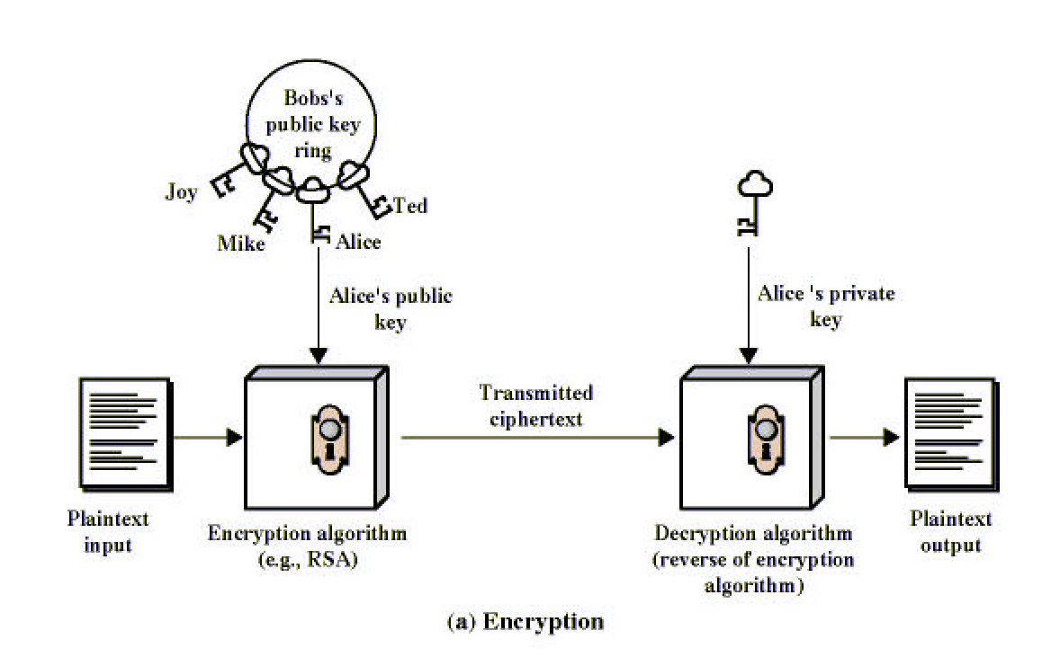
Public-Key Cryptography
Notes:
Stallings Fig 9-1.

Slide 31
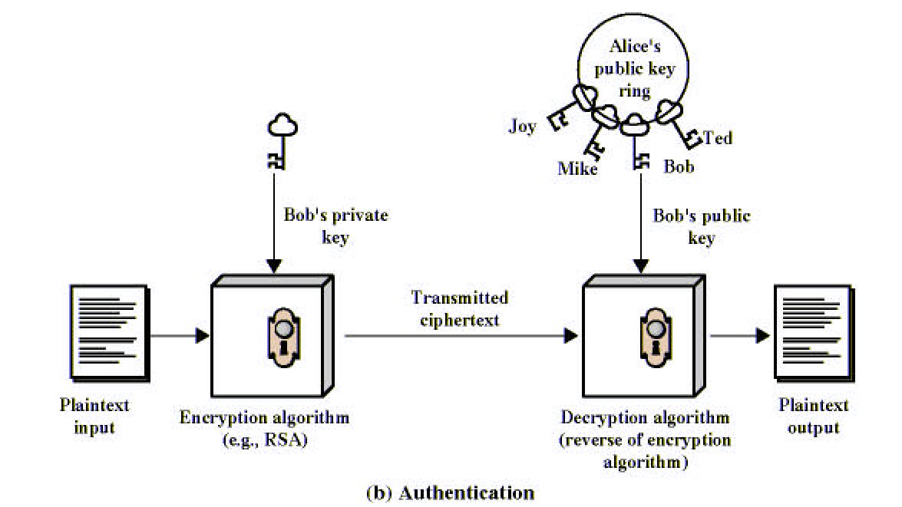
Public-Key Cryptography
Notes:
Stallings Fig 9-1.

Slide 32
What Is Elliptic Curve Cryptography (ECC)?
Elliptic curve cryptography [ECC] is a public-key cryptosystem just like RSA, Rabin, and El Gamal.
Every user has a public and a private key.
Public key is used for encryption/signature verification.
Private key is used for decryption/signature generation.
Elliptic curves are used as an extension to other current cryptosystems.
Elliptic Curve Diffie-Hellman Key Exchange
Elliptic Curve Digital Signature Algorithm

Slide 33
Using Elliptic Curves In Cryptography
The central part of any cryptosystem involving elliptic curves is the elliptic group.
All public-key cryptosystems have some underlying mathematical operation.
RSA has exponentiation (raising the message or ciphertext to the public or private values)
ECC has point multiplication (repeated addition of two points).

Slide 34
Generic Procedures of ECC
Both parties agree to some publicly-known data items
The elliptic curve equation
values of a and b
prime, p
The elliptic group computed from the elliptic curve equation
A base point, B, taken from the elliptic group
Similar to the generator used in current cryptosystems
Each user generates their public/private key pair
Private Key = an integer, x, selected from the interval [1, p-1]
Public Key = product, Q, of private key and base point
(Q = x*B)

Slide 35
Example – Elliptic Curve Cryptosystem Analog to El Gamal
Suppose Alice wants to send to Bob an encrypted message.
Both agree on a base point, B.
Alice and Bob create public/private keys.
Alice
Private Key = a
Public Key = P_{A} = a * B
Bob
Private Key = b
Public Key = P_{B} = b * B
Alice takes plaintext message, M, and encodes it onto a point, P_{M}, from the elliptic group

Slide 36
Example – Elliptic Curve Cryptosystem Analog to El Gamal
Alice chooses another random integer, k from the interval [1, p-1]
The ciphertext is a pair of points
P_{C} = [ (kB), (P_{M} + kP_{B}) ]
To decrypt, Bob computes the product of the first point from P_{C} and his private key, b
b * (kB)
Bob then takes this product and subtracts it from the second point from P_{C}
(P_{M} + kP_{B}) – [b(kB)] = P_{M} + k(bB) – b(kB) = P_{M}
Bob then decodes P_{M} to get the message, M.

Slide 37
Example – Compare to El Gamal
The ciphertext is a pair of points
P_{C} = [ (kB), (P_{M} + kP_{B}) ]
The ciphertext in El Gamal is also a pair.
C = (g^{k} mod p, mP_{B}^{k} mod p)
--------------------------------------------------------------------------
Bob then takes this product and subtracts it from the second point from P_{C}
(P_{M} + kP_{B}) – [b(kB)] = P_{M} + k(bB) – b(kB) = P_{M}
In El Gamal, Bob takes the quotient of the second value and the first value raised to Bob’s private value
m = mP_{B}^{k} / (g^{k})^{b} = mg^{k*b} / g^{k*b} = m

Slide 38
Diffie-Hellman (DH) Key Exchange

Slide 39
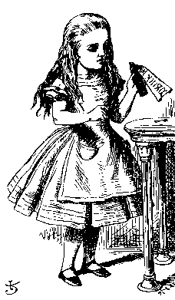
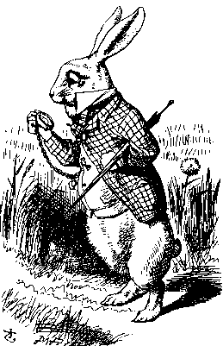
ECC Diffie-Hellman
Public: Elliptic curve and point B=(x,y) on curve
Secret: Alice’s a and Bob’s b
a(x,y)
b(x,y)
Alice, A
Bob, B
Alice computes a(b(x,y))
Bob computes b(a(x,y))
These are the same since ab = ba

Slide 40
Example – Elliptic Curve Diffie-Hellman Exchange
Alice and Bob want to agree on a shared key.
Alice and Bob compute their public and private keys.
Alice
Private Key = a
Public Key = P_{A} = a * B
Bob
Private Key = b
Public Key = P_{B} = b * B
Alice and Bob send each other their public keys.
Both take the product of their private key and the other user’s public key.
Alice → K_{AB} = a(bB)
Bob → K_{AB} = b(aB)
Shared Secret Key = K_{AB} = abB

Slide 41
Why use ECC?
How do we analyze Cryptosystems?
How difficult is the underlying problem that it is based upon
RSA – Integer Factorization
DH – Discrete Logarithms
ECC - Elliptic Curve Discrete Logarithm problem
How do we measure difficulty?
We examine the algorithms used to solve these problems

Slide 42
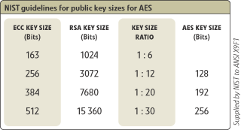
Security of ECC
To protect a 128 bit AES key it would take a:
RSA Key Size: 3072 bits
ECC Key Size: 256 bits
How do we strengthen RSA?
Increase the key length
Impractical?

Slide 43
Applications of ECC
Many devices are small and have limited storage and computational power
Where can we apply ECC?
Wireless communication devices
Smart cards
Web servers that need to handle many encryption sessions
Any application where security is needed but lacks the power, storage and computational power that is necessary for our current cryptosystems

Slide 44
Benefits of ECC
Same benefits of the other cryptosystems: confidentiality, integrity, authentication and non-repudiation but…
Shorter key lengths
Encryption, Decryption and Signature Verification speed up
Storage and bandwidth savings

Slide 45
Comparable Key Sizes for Equivalent Security
Symmetric scheme (key size in bits) | ECC-based scheme (size of n in bits) | RSA/DSA (modulus size in bits)
56 | 112 | 512
80 | 160 | 1024
112 | 224 | 2048
128 | 256 | 3072
192 | 384 | 7680
256 | 512 | 15360
Notes:
45
Stallings Table 10.3 - “ Comparable Key Sizes in Terms of Computational Effort for Cryptanalysis” ompares various algorithms by showing comparable key sizes in terms of computational effort for cryptanalysis. As can be seen, a considerably smaller key size can be used for ECC compared to RSA. Furthermore, for equal key lengths, the computational effort required for ECC and RSA is comparable. Thus, there is a computational advantage to using ECC with a shorter key length than a comparably secure RSA.

Slide 46
Agenda
Introduction
Elliptic curve
Elliptic curve cryptography
Summary
Test your understanding
References

Slide 47
Summary of ECC
“Hard problem” analogous to discrete log
Q=kP, where Q,P belong to a prime curve
given k,P → “easy” to compute Q
given Q,P → “hard” to find k
known as the elliptic curve logarithm problem
k must be large enough
ECC security relies on elliptic curve logarithm problem
compared to factoring, can use much smaller key sizes than with RSA etc
for similar security ECC offers significant
computational advantages

Slide 48
Agenda
Introduction
Elliptic curve
Elliptic curve cryptography
Summary
Test your understanding
References

Slide 49
Test your understanding
What is an elliptic curve?
What is the zero point of an elliptic curve?
What is the sum of three points on an elliptic curve that lie on a straight line?
Does the elliptic curve equation y² = x³ + 10x + 5 define a group over Z₁₇?

Slide 50
Agenda
Introduction
Elliptic curve
Elliptic curve cryptography
Summary
Test your understanding
References

Slide 51
References
1. William Stallings, Cryptography and Network Security, 6th Edition, Pearson Education, March 2013.
2. Charlie Kaufman, Radia Perlman and Mike Speciner, “Network Security”, Prentice Hall of India, 2002.

